Slide 1
DERMA-BLISS-CLINIC
Name – Sarvesh Rajesh Konde
Roll No. – 17030925014
SYMCA

Slide 2
DERMA BLISS CLINIC MANAGEMENT SYSTEM
Project Aim & Clinical Context
The Clinical Challenge
• Specialized Practice: Operating high-volume aesthetic cosmetology, trichology, and laser treatments.
• Paper Bottlenecks: Physical appointment registers lead to scheduling double-bookings and waiting room congestion.
• Fragmented Records: Paper prescription slips hinder historical review of treatment progressions and drug allergies.
• Financial Leakage: Inability to track uncollected procedure payments, discounts, and split UPI/Card receipts.
Primary Project Aim
✔ Unified Digital Transformation: Replace disconnected paper logs with an enterprise-grade, secure 3-tier clinical management ecosystem.
✔ Clinical Quality & EMR: Provide Doctor with instant access to patient histories, examination notes, and high-resolution photo archives.
✔ Cryptographic Integrity: Generate standardized, tamper-evident digital prescriptions with SHA-256 signature verification.
✔ Cross-Platform Mobility: Empower patients with an intuitive mobile app for booking, live queue tokens, and digital health records.

Slide 3
DERMA BLISS CLINIC MANAGEMENT SYSTEM
System Architecture & Technology Stack
Presentation Layer (Admin)
Responsive HTML5, CSS3
Tailored for clinic front-desk and doctor's tablet. Zero complex build dependencies. Real-time REST communication.
Mobile Layer (Patient Portal)
React Native, TypeScript, Expo 51, React Navigation
Cross-platform iOS and Android client. Secure local credential storage, push-ready architecture, interactive booking.
Application Layer (Backend)
Java 21 LTS, Spring Boot 3.3.4, Spring Security, Hibernate
Layered service/controller micro-architecture. Stateless JWT tokens, OpenHTMLtoPDF generation, Flyway migrations.
Persistence Layer (Database)
MySQL Server, ACID Transactions, Docker Compose
19 fully normalized relational tables. Concurrency protection on appointment slots, immutable audit logging.

Slide 4
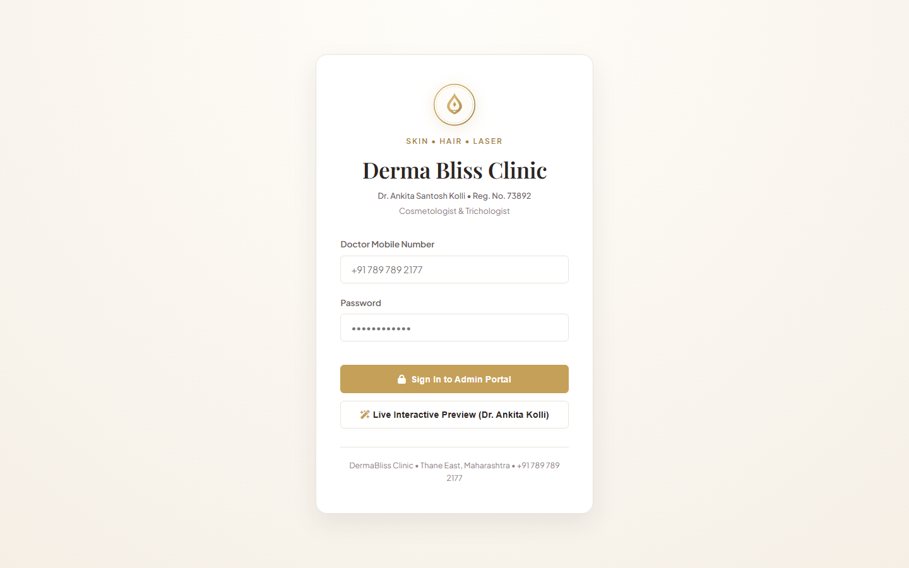
SECURE, ROLE-BASED ACCESS CONTROL (RBAC)
Doctor & Administrative Authentication
Key Functional Capabilities
• Doctor’s Credential Validation: Phone-number and password-based login with bcrypt hash verification.
• Official Medical Badge: Highlights registration #73892 to reinforce authentic practitioner governance.
• Stateless JWT Issuance: Signs HMAC-SHA256 access tokens and refresh tokens for secure session maintenance.
• Live Preview Mode: Built-in instant preview mechanism allowing demo inspection without external barriers.

Slide 5
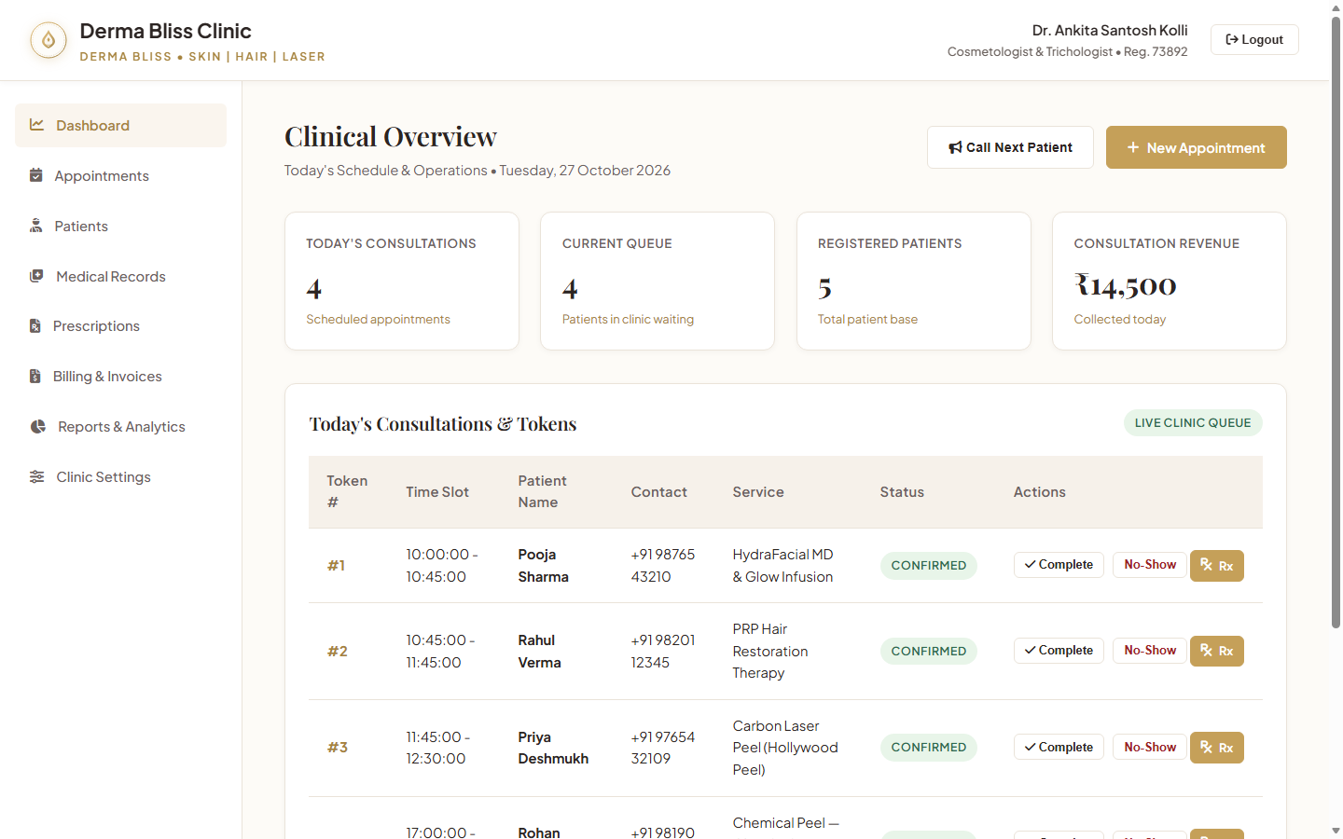
REAL-TIME PRACTICE ANALYTICS & TODAY'S QUEUE
Executive Clinical Operations Dashboard
Key Functional Capabilities
• Comprehensive Daily KPIs: Displays active registered patients (5), today's appointments (4), and collections (₹8,000).
• Live Queue Management: Real-time token caller (#01 Pooja Sharma) with immediate call-next and complete actions.
• Today's Chronological Schedule: Time slot, patient name, procedure category, and status indicators.
• Quick Action Shortcuts: Single-click shortcuts to register walk-ins, book appointments, or write prescriptions.

Slide 6
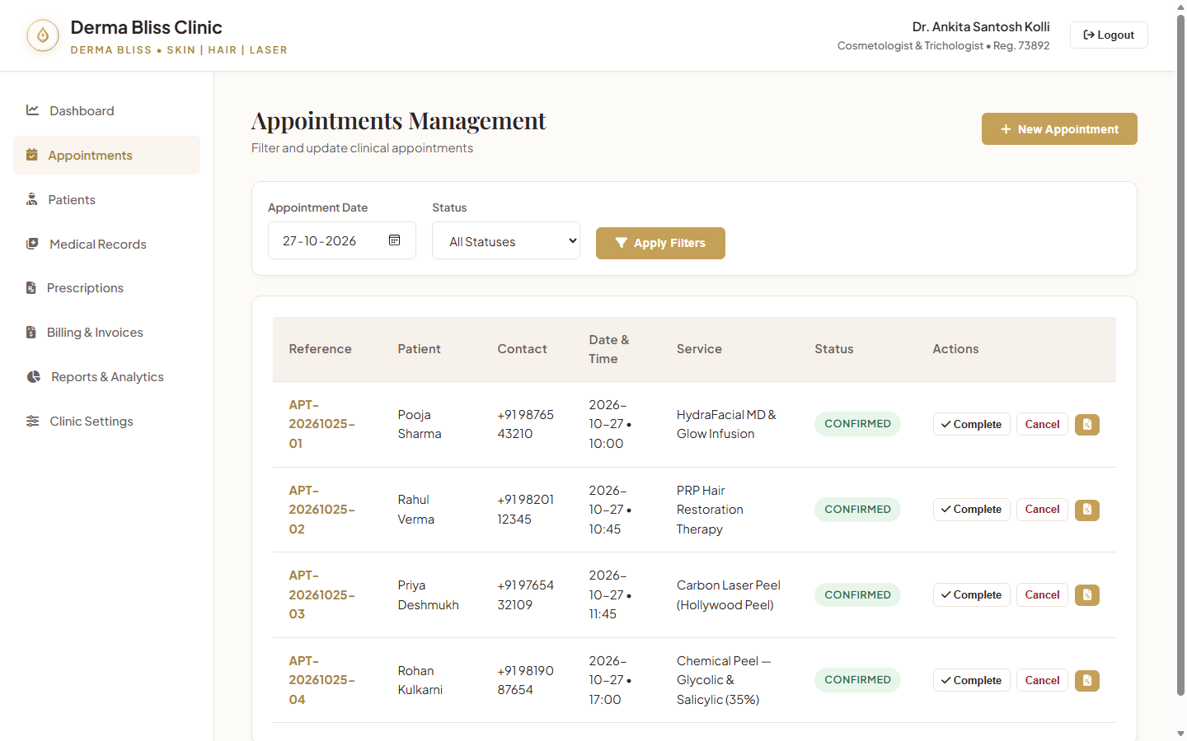
COLLISION-FREE BOOKING & SESSION CALENDARS
Smart Appointment Scheduling System
Key Functional Capabilities
• Clinic Shift Adherence: Enforces Morning (10 AM - 1 PM) and Evening (5 PM - 9 PM) clinic consultation hours.
• Service-Specific Durations: Automatically schedules 45 min for HydraFacial/Laser, 60 min for PRP, 15 min for follow-ups.
• Anti-Collision Locks: Database-level transaction verification eliminates overlapping doctor appointments.
• Status Tracking: Seamlessly manages CONFIRMED, CHECKED-IN, COMPLETED, and RESCHEDULED lifecycles.

Slide 7
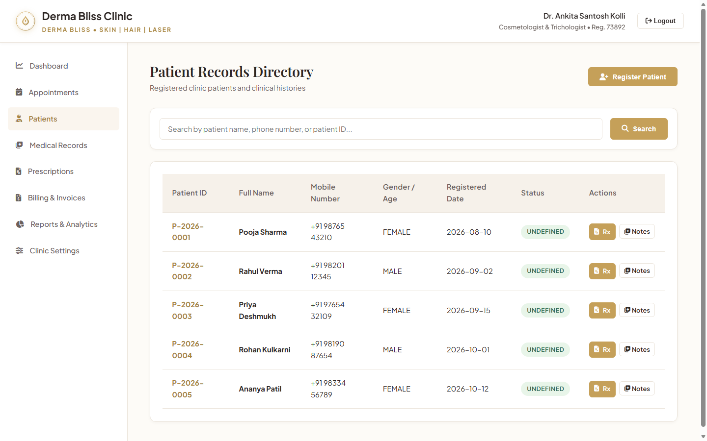
CENTRALIZED PATIENT RECORDS & ALLERGY WARNINGS
Patient Demographic & Medical Registry
Key Functional Capabilities
• Unique Patient Identifier: System assigns tracking IDs (e.g., P-2026-0001) for clean longitudinal health records.
• Critical Allergy Alerts: Highlights drug sensitivities (Sulfa drugs, Aspirin, Fragrances) in prominent visual tags.
• Complete Demographics: Captures emergency contact, age, gender, blood group, and past medical history.
• Deep Record Integration: Direct link to view patient's historical consultations, prescriptions, and past payments.

Slide 8
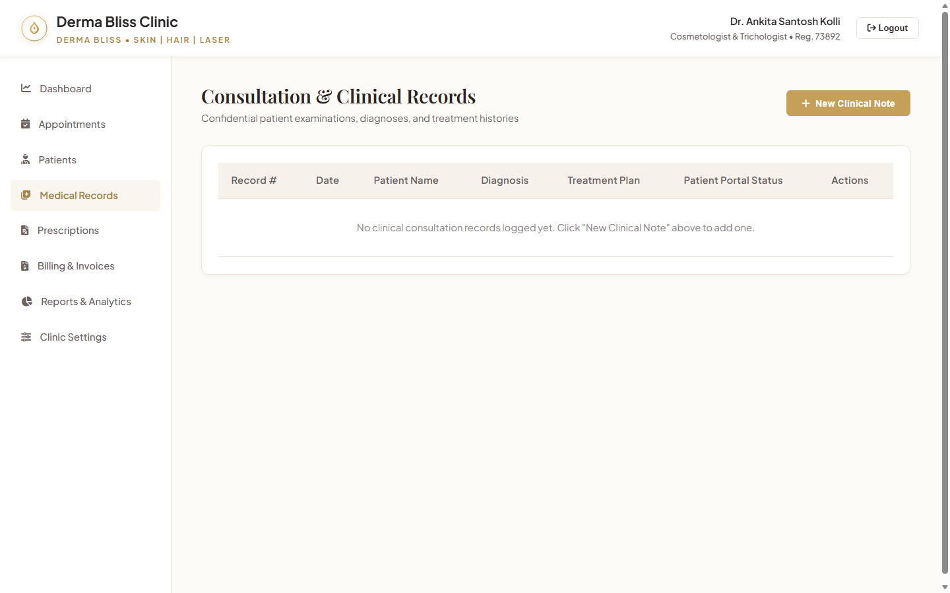
SYSTEMATIC CLINICAL NOTES & DIAGNOSTIC DOCUMENTATION
Electronic Medical Records (EMR) & Consultations
Key Functional Capabilities
• Structured Consultations: Dedicated fields for Chief Complaints, Examination Findings, Vitals, and Treatment Plans.
• Cosmetology & Trichology Focus: Records acne lesion counts, pigmentation severity, and scalp Norwood classifications.
• Vital Tracking: Tracks Blood Pressure (118/76 mmHg), Pulse (74 bpm), and Body Weight (56.5 kg) at each visit.
• Immutable Auditability: Consultation notes are securely tied to Dr. Ankita Kolli's medical ID.

Slide 9
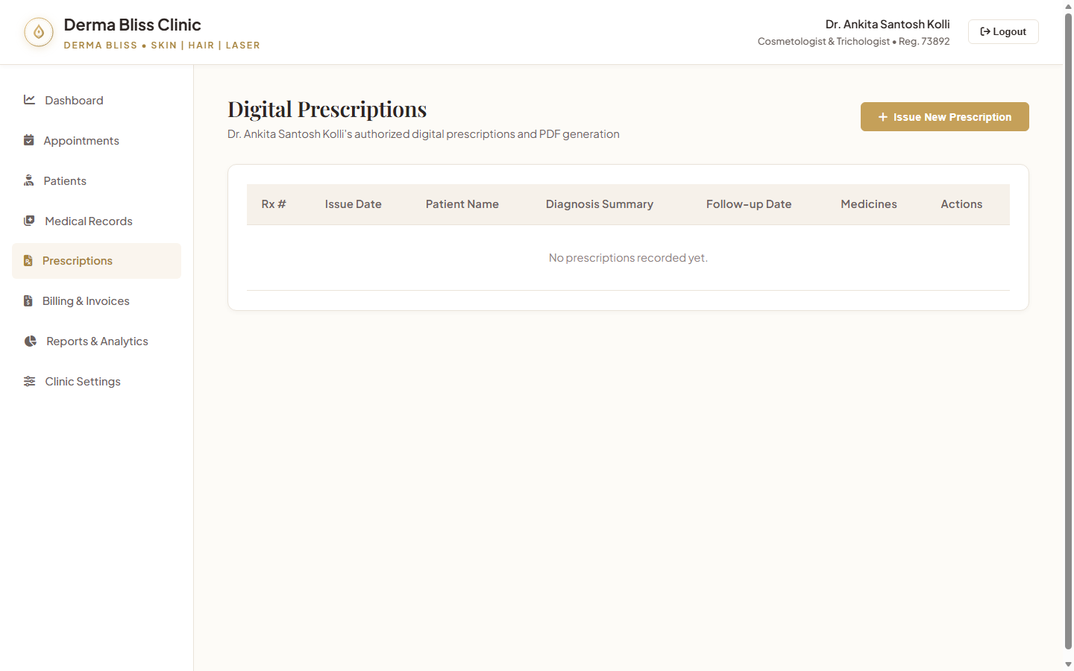
TAMPER-EVIDENT FORMULATIONS & CRYPTOGRAPHIC HASH
Digital Prescription Pad & PDF Generator
Key Functional Capabilities
• Standardized Cosmeceutical Formulary: Pre-built dosage templates for clindamycin, adapalene, retinoids, and oral agents.
• Cryptographic Signature: Generates SHA-256 hash ensuring prescription integrity and pharmacy verification.
• Administration Guidelines: Auto-includes patient instructions (sunscreen protocols, cleansing routines, follow-up dates).
• Instant PDF Generation: Generates print-ready PDFs with official clinic header and doctor registration details.

Slide 10
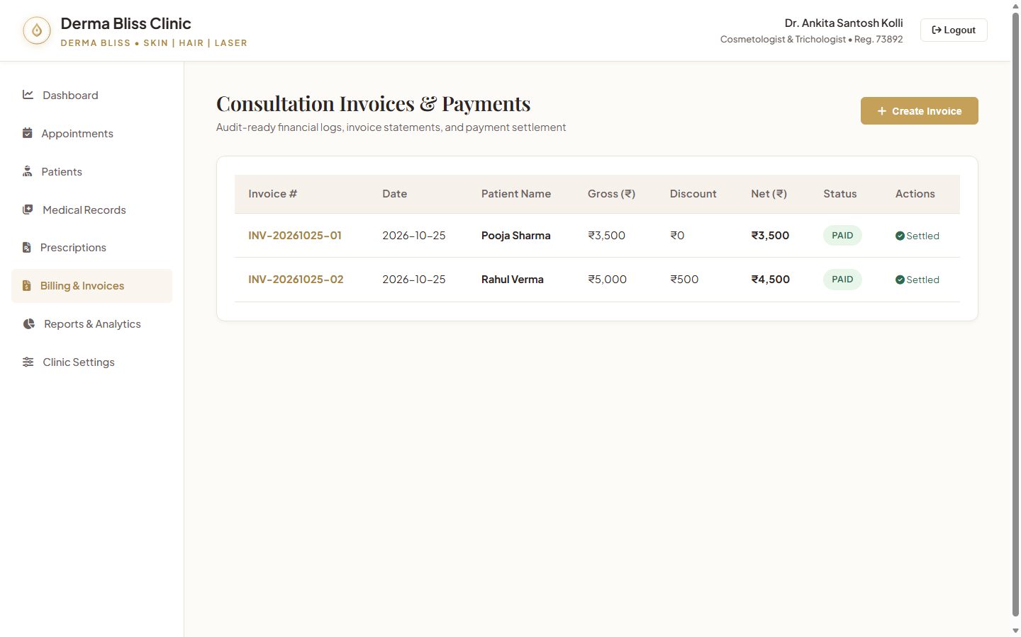
MULTI-MODE PAYMENT TRACKING & TAX ACCOUNTING
Billing, Invoicing & Payment Reconciliation
Key Functional Capabilities
• Automated Invoicing: Calculates procedure costs, consultation fees, and promotional discounts automatically.
• Multi-Channel Settlements: Records payments across UPI (Google Pay, PhonePe), Cards (POS), and Cash.
• Audit-Compliant Invoices: Generates sequential invoice numbers (e.g. INV-20261025-01) with itemized receipts.
• Real-Time Balance Ledger: Tracks pending invoice balances and prevents unrecorded procedure revenue.

Slide 11
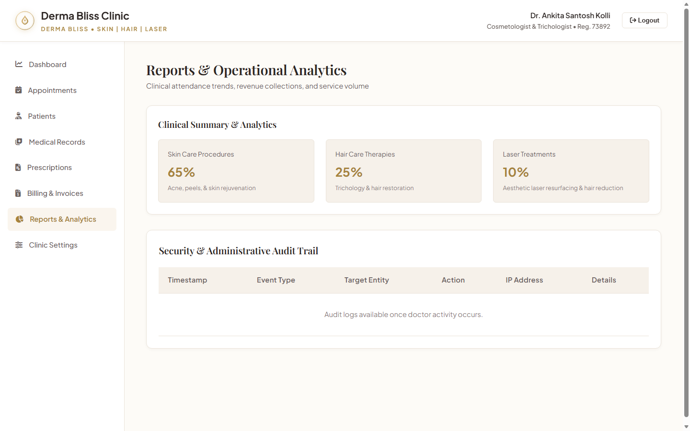
REVENUE DISTRIBUTIONS, SERVICE POPULARITY & FOOTFALL
Practice Analytics & Financial Intelligence
Key Functional Capabilities
• Category Revenue Breakdown: Pinpoints revenue across Skin Care (₹3,500), Hair Care (₹5,000), and Laser Treatments.
• Payment Channel Share: Tracks collections breakdown (UPI: 62% | Card: 24% | Cash: 14%) for banking reconciliation.
• Patient Retention Analytics: Monitors new patient consultations versus repeat aesthetic maintenance sessions.
• Financial Export: Supports rapid CSV and PDF exports for clinic accounting and statutory tax filings.

Slide 12
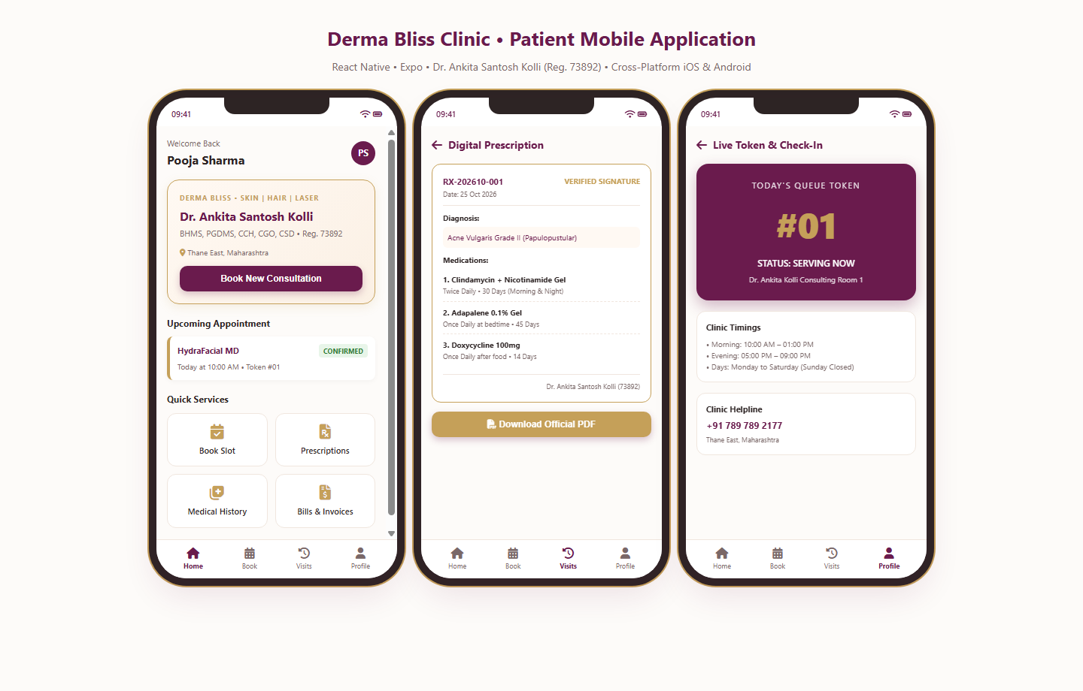
REACT NATIVE IOS & ANDROID SMARTPHONE EXPERIENCE
Cross-Platform Patient Mobile Portal
Key Functional Capabilities
• Patient Self-Service: Intuitive mobile interface allowing patients to schedule appointments and view open slots.
• Live Queue Token Tracker: Patients track their sequential token (#01) from home, eliminating crowded waiting rooms.
• Paperless Medical Wallet: Instant access to active prescriptions (RX-202610-001) and diagnostic instructions.
• Direct Clinic Communication: One-tap calling to clinic helpline (+91 789 789 2177) and clinic map location.

Slide 13
DERMA BLISS CLINIC MANAGEMENT SYSTEM
Data Integrity & Defense-in-Depth Security
Normalized Relational Architecture
✔ 19 Fully Normalized Tables: Structured schema covering Users, Patients, Services, Doctor Schedules, Appointments, EMR, Prescriptions, Invoices, and Tokens.
✔ Flyway Versioned Migrations: V1__init_schema.sql and V2__seed_initial_data.sql guarantee identical schema deployments across dev, stage, and prod.
✔ Financial Precision: Monetary fields strictly typed as DECIMAL(10,2) to eliminate floating-point rounding inaccuracies in clinic billing.
✔ Optimized Indexing: Dedicated composite B-Tree indexes on patient phone numbers, appointment dates, and doctor schedules.
Healthcare Security Controls
🔒 Cryptographic Authentication: Salted BCrypt password hashing (cost factor 12) + HMAC-SHA256 signed stateless JWT tokens.
🔒 Role-Based Access Control: Granular security expressions (@PreAuthorize) preventing horizontal and vertical privilege escalation.
🔒 OWASP Hardening: Parameterized JPA queries eliminate SQL injection; strict Content-Type and CORS headers prevent cross-site scripting (XSS).
🔒 Tamper-Proof Audit Trails: Every patient record alteration, prescription issuance, and invoice creation records user ID, IP address, and timestamp.

Slide 14
DERMA BLISS CLINIC MANAGEMENT SYSTEM
Future Enhancements & Strategic Roadmap
1. AI Dermatological Image Diagnostics
Deep learning CNN models to grade acne severity, calculate Fitzpatrick pigmentation index, and assess serial treatment recovery.
2. WhatsApp Business Cloud Messaging
Automated appointment reminders, digital prescription delivery, and 2-way patient booking confirmation via WhatsApp.
3. Tele-Dermatology & Video Visits
End-to-end encrypted WebRTC video consultations for remote aesthetic follow-ups and chemical peel healing monitoring.
4. Smart Consumable Stock Tracking
Automated inventory management for aesthetic serums, laser cooling gels, and PRP vacutainers with batch expiry alerts.
5. Ayushman Bharat (ABDM) Integration
National health digital connectivity through ABHA IDs, enabling verified longitudinal electronic health record sharing.
6. Multi-Branch Scalability
Expanding current Spring Boot backend into a multi-tenant cloud architecture to seamlessly support new Derma Bliss branches.

Slide 15
Thank You!

